Slide 1
The retrieval of greenhouse gases concentrations from the measured solar spectrum
Student Trifonova-Yakovleva Alisa
Scientific advisor Chesnokova Tatyana
V.E. Zuev Institute of Atmospheric Optics
Notes:
Dear Ladies and Gentlemen, my name is Alisa Trifonova-Yakovleva. I am a first-course Ph. D. student of the Institute of Atmospheric Optics. Let me introduce you the research work concerning the retrieval of greenhouse gases concentrations from the measured solar spectrum. My scientific advisor is Chesnokova Tatyana.

Slide 2
Content
Relevance
Objectives
Remote sensing measurements
Retrieval
SFIT4
Results
Conclusion
Notes:
This presentation consists of the following parts: the first part describes the relevance of the work, underlining the importance of the scope of the study for the climate change understanding. The next part is about the objectives of the study. The third is the short review of remote sensing measurements. The most important part considers the process of the retrieval, including the forward and inverse models and error estimation. Sfit4 is the flexible software for the retrieval. Results and conclusion follow the sfit4 description.

Slide 3
Abstract
The remote sensing measurements of greenhouse gases concentrations in atmosphere provide information about the concentration changes and their results may be used for modelling of greenhouse gases sources and sinks. In this study the approach to the gas concentration retrieval from the measured solar spectrum using SFIT4 software is considered. The results of the retrieval with different spectroscopic parameters are compared.
Notes:
The remote sensing measurements of greenhouse gas concentrations in atmosphere provide information about the concentration changes and their results may be used for modelling of greenhouse gases sources and sinks. In this study the approach to the gas concentration retrieval from the measured solar spectrum using SFIT4 software is considered. The results of the retrieval with different spectroscopic parameters are compared.

Slide 4
Relevance
Climate change
Greenhouse effect
Greenhouse gases concentrations increasing
Greenhouse gases monitoring
modelling
strict requirements!
The requirements for the accuracy of greenhouse gases determination
Buchwitz, M., F. Chevallier, P. Bergamaschi, et al.. User Requirements Document for the GHG-CCI project of ESA’s Climate Change Initiative, 2020.
Notes:
The greenhouse effect and its influence on Earth climate is one of the most actively investigated topics. Carbon dioxide and methane are the two most important anthropogenic greenhouse gases driving global climate change. Increasing atmospheric concentrations of these essential climate variables leads to global warming with adverse consequences such as rising sea levels. It is therefore important to monitor the spatial distribution and the time evolution of these gases and to improve our knowledge of their various natural and anthropogenic sources and sinks.
Climate modelling puts the stringent demand to the data accuracy. For example, the breakthrough precision for CO2 volume mixing ratio required is less than 3 ppm, while for methane it is less than 17 ppb. To meet such requirements, a number of instruments and retrieval algorithms are developing.

Slide 5
Objectives
Greenhouse gases concentrations retrieval
Software upgrading for monitoring accuracy increasing
Error estimation
Notes:
The objectives of this study is the retrieval of greenhouse gases concentrations in atmosphere from the measured solar spectrum. The gases under consideration are CO2, methane and the others. The software upgrading for the greenhouse monitoring accuracy increasing is implied. It assumes searching for the optimal model and retrieval parameters. The approaches for the error estimations should be considered for the proper understanding of the reality approximation consistency.

Slide 6
Remote sensing measurements
Measured atmospheric spectrum at Kourovka station
Atmospheric spectrum
Wavenumber, cm⁻¹
Notes:
Remote sensing of the greenhouse gases in atmosphere is performed by different types of instruments. They include satellite, airborne and
ground-based instruments.
Satellite measurements provide information about spatial distribution of the gas, but its accuracy is not enough. To validate satellite measurements, high resolution ground-based Fourier-transform infrared spectroscopy spectrometer may be used.
Ground-based FTIR measurements of the gas concentrations profile are accurate and precise.
The light from the sun goes through the atmosphere reaching the spectrometer. The absorption coefficient of different gases in different absorption lines transforms the spectrum of the light coming to the top of atmosphere to the spectrum measured near the ground. Knowing the sun spectrum at the top of the atmosphere and the spectrum measured by the ground-based instrument, one can retrieve the amount and the vertical profile of the gas concentration in the atmosphere. This is an inverse problem.
To solve it the apriori profiles of the gaseous concentrations and atmospheric state variables are necessary. This apriori information may be taken from the reanalysis data above the measurement location or from satellite measurements or from some other sources.

Slide 7
Retrieval
Forward model
Inverse problem
Error estimation
Notes:
The retrieval itself consists of a forward model, inversion and error analysis. It is an iterative process of solving the forward model, comparing the result with the measured spectrum and correcting the parameters of the forward model. The process lasts until the convergence is reached. Let us consider it in details.

Slide 8
Retrieval
Forward model
state vector of the gas concentration to retrieve
measured spectrum
forward model
transmittance
Notes:
The forward model is the model of the spectrum transformation by gaseous absorption. To model the absorption, the detailed information about the spectroscopic parameters is needed. This information may be found in spectroscopic databases, e.g. in HITRAN. This data base contains line-by-line parameters that reflect values of individual transitions between energy levels of rovibronic states that are required by high-resolution transfer codes.
Calculations of absorption cross section and then transmittance in the forward model for each layer of the atmosphere is performed from spectroscopic parameters using line-by-line model. For the retrieval and sensitivity study we need the ﬁrst derivative, the so-called Jacobian of the forward model, also called the weighting function matrix K. This matrix includes the transmittance for each layer of the atmosphere, which in turn includes the absorption cross section of the gas. Using the K matrix, the forward model can be linearized.

Slide 9
Retrieval
Inverse problem
ill-posed problem regularization is needed!
inversion argmin
a priori suggestion
covariance matrix
noise
Notes:
The inversion of the functional F is an ill-posed problem. In the presence of noise, information content of spectra in nadir or zenith geometry is limited, not more than a few bit, inﬂuence of noise grows exponentially, but for numerical reasons, atmospheric bins should be small. The number of layers is higher than information content, therefore regularization is needed. With the regularization the problem of approximate solution searching is transformed into argument of the minimum of the cost function searching.

Slide 10
Retrieval
Error estimation
Smoothing error
Retrieval noise
Forward model error
Model parameter error
Notes:
The error in the retrieval may be divided into several summands. Each of them is responsible for the specific error.

Slide 11
Retrieval
Error estimation
Smoothing error
Covariance of the smoothing error
Retrieval noise
Forward model error
Model parameter error
to estimate the smoothing error covariance, the covariance matrix of a real ensemble of states must be known
Notes:
The smoothing error gives an estimate of how the observing system smooths the profile of the gas concentration. It includes x (the true state of the atmosphere), apriori profile xa and smoothing kernels A. Because the true state x is not normally known, we cannot estimate the actual smoothing error. What is really required is a description of the statistics of the error, which must be calculated from the mean and covariance over some appropriate ensemble of states. Therefore, to estimate the smoothing error covariance, the covariance matrix of a real ensemble of states must be known

Slide 12
Retrieval
Error estimation
Smoothing error
Retrieval noise
Forward model error
Model parameter error
matrices may be calculated and can be used for sensitivity studies or error calculations
Notes:
Model parameter error is an estimate of the error due to parameters b in model. b is a set of a forward model parameters, that may contain
both random and systematic components on various time and space scales. The error in the retrieval due to errors in the forward model parameters as well as the evaluation of the sensitivities is straightforward in principle.

Slide 13
Retrieval
Error estimation
Smoothing error
Retrieval noise
Forward model error
Model parameter error
Difficult to assess if true forward model is not known
Notes:
Modelling error can be hard to evaluate, because it requires a model for f which includes the correct physics. If the correct physics is known and can be modelled accurately, and F is simply a numerical approximation for efficiency's sake, then evaluating modelling error is straightforward. But if f is not known in detail, or so horrendously complex that no proper model is feasible, then modelling error can be tricky to estimate. Modelling error is likely to be systematic.

Slide 14
Retrieval
Error estimation
Smoothing error
Retrieval noise
Forward model error
Model parameter error
Caused by noise on spectrum
Notes:
And the last one is the retrieval noise caused by noise on spectrum. It is usually the easiest component to evaluate. Measurement noise € is usually random, and is normally unbiased and often uncorrelated between channels, and has a known covariance matrix.

Slide 15
SFIT4
Infrared Working Group Retrieval Code, SFIT
The core SFIT code consists of a set of modules written in Fortran to:
Extract HITRAN spectral lines
Format measurement data
Run SFIT retrieval
https://wiki.ucar.edu/display/sfit4
Notes:
To perform the retrieval the SFIT4 software may be used. It is a flexible instrument allowing user to specialize the parameters of the retrieval.
To retrieve gas concentration profile or the total gas amount several inputs are needed.
The first is the spectrum measured by infrared spectrometer. From this spectrum the required information will be retrieved.
The state of the atmosphere at the moment of the measurement should also be known. It includes temperature, pressure and water vapor profiles.
The last is the suggestions about apriori gas concentrations profile.

Slide 16
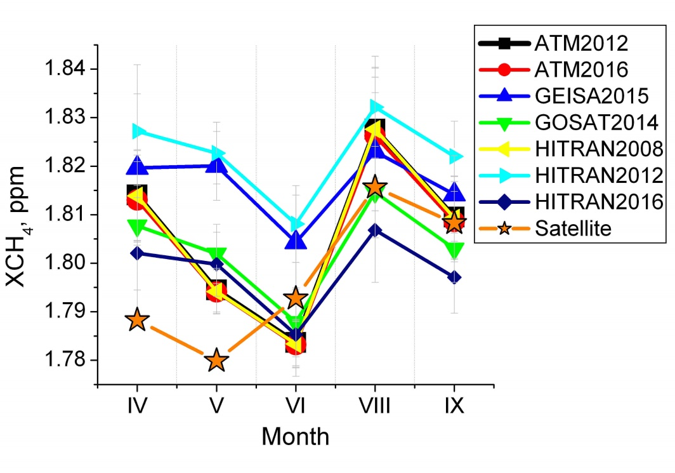
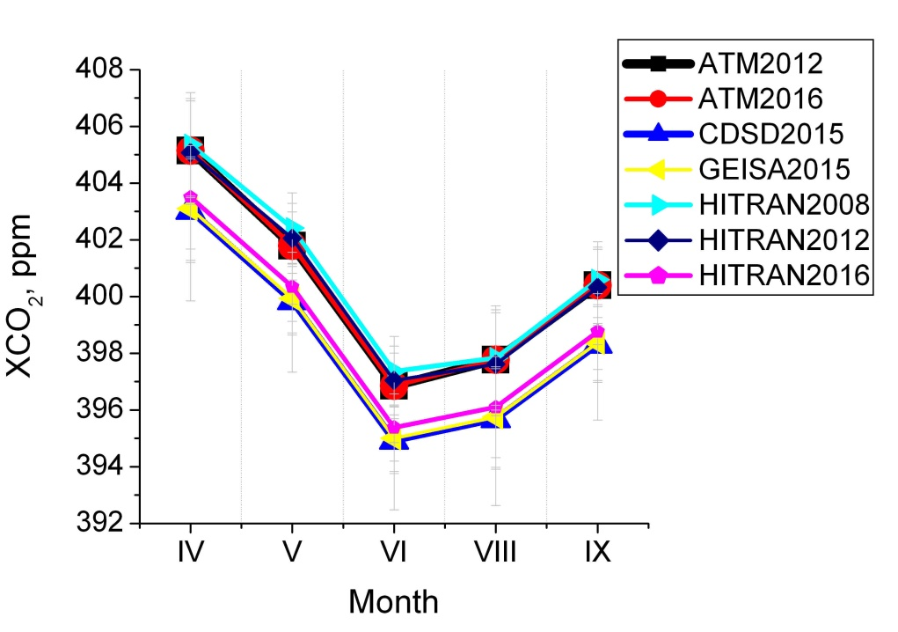
Monthly averaged СН4 and CO2 atmospheric volume mixing ratios retrieved from FTS measured 950 spectra using different spectroscopic databases. Kourovka, 2015
Results of the retrieval
Retrievals of the atmospheric content of greenhouse gases from high resolution absorption spectra of solar radiation with use of different spectroscopic line parameters
Tatyana Yu. Chesnokova, Alexey V. Chentsov, Nikita V. Rokotyan, Vyacheslav I. Zakharov, Konstantin M. Firsov
Notes:
The results of the retrieval of carbon dioxide and methane volume mixing ratio from the spectrum measured at Kourovka station with use of SFIT4 software are shown at this picture.
Different lines relate to the different spectroscopic databases of line-by-line parameters. The databases are regularly updated,
but the new version is not always better than the previous one.
The difference in the atmospheric CH4 content, retrieved with different spectroscopic databases was 1.5% for monthly averaged values and 4% for individual measurements. The difference in the CO2 atmospheric contents did not exceed 0.6%. These differences are comparable with annual trends of CH4 and CO2 atmospheric concentration growths, which are 0.4-0.6% in 2015-2017.

Slide 17
Conclusion
The requirements for the retrieval accuracy are very strict. The uncertainties in line-by-line parameters in spectroscopic databases lead to discrepancy in retrieval results comparable with annual trends of gas concentration growth.
Attributing and quantifying of the uncertainties in the retrieval process is necessary. It allows to understand the measure of the accuracy in the real gas profile estimation.
The full error estimation is in progress.
Notes:
The requirements for the retrieval accuracy are very strict. The uncertainties in line-by-line parameters in spectroscopic databases lead to discrepancy in retrieval results comparable with annual trends of gas concentration growth.
Attributing and quantifying of the uncertainties in the retrieval process is necessary. It allows to understand the measure of the accuracy in the real gas profile estimation.

