Slide 1
Olefins C3-C4 oxidation under the action of barrier discharge in plasma-chemical reactor with cryogenic cooling
Russian Academy of Sciences Siberian Branch
Institute of Petroleum Chemistry
by Grigoriy Dankovtsev, postgraduate
Sergey Kudrjashov, D. Sci. Chem.
Notes:
Good afternoon, fellow researchers, soon-to-be philosophy doctors and scientist wannabes. Today I am going to talk about DBD-induced oxidation of olefins. This is basically, what I do at work these days.

Slide 2
Outline
Importance;
Goals;
Work plan;
The process;
Completed tasks;
Conclusion.
Notes:
I will tell you why research in this direction is relevant. I’ll discuss the principle of reaction, the goals that were set, the work to be done and the tasks that have been completed so far.

Slide 3
Importance
An important trend for industrial organic synthesis;
New method of oxidation of olefins gas;
Simplicity of method in comparison with other industrial methods (gas-phase or liquid-phase catalytic methods).
Notes:
Oxidation of gaseous olefins C3-C4 for the synthesis of oxides is an important task in industrial organic synthesis. Liquid or gas-phase catalysts are used for that in chemical industry. However, these have essential limitations (preparation, regeneration of catalysts, high temperature and pressure requirements) which make researchers look for alternative ways to produce gaseous olefins.

Slide 4
Goals
For the first time the oxidation regularities of C3-C4 olefins in a plasma-chemical reactor with barrier discharge and cryogenic cooling will be studied;
A mathematical model of the chemical kinetics of the process will be developed, and a reaction mechanism will be proposed;
A new way of managing barrier discharge reactions involving gaseous hydrocarbons will be justified.
Notes:
Provided everything goes as planned, we’ll get to study regularities in the process of oxidation of C3-C4 olefins in the barrier discharge for the first time ever; a kinetic model of the process will be developed. We expect to be able to come up with the mechanism of reaction; a new method of reaction control in the barrier discharge with participation of gaseous hydrocarbons will be proposed and substantiated.

Slide 5
Work plan

Slide 6
First year
Cryogenic unit
Plasma-chemical reactor
Assembly of the units
Testing
Notes:
Work plan of the first year.

Slide 7
Second year
Development of a methodology
Study of the oxidative conversion process
Notes:
Work plan of the second year.

Slide 8
Third year
Investigation of Butene-1 oxidative conversion process
Development of the mathematical model
Notes:
Work plan of the third year.

Slide 9
Fourth year
Verification of the model
Identification of limiting stages of the reaction mechanism
Determination of optimal process conditions
Notes:
Work plan of the fourth year. I'm still at the beginning of my way and I have already achieved some of the goals, namely, the design and production of a plasma chemical reactor and a cryogenic unit. Why don’t we take a look at what they are in more detail. Let's start with the process.

Slide 10
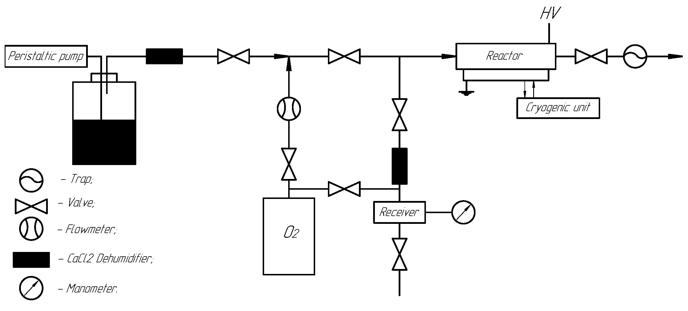
The process
Figure 1 – The process
Notes:
Feeding and measuring of the amount of olefin in the gaseous state is carried out by means of a peristaltic pump. In the next step, the olefin mixed with oxygen enters the reactor. The reactor is cooled down by means of a cryogenic unit to about - 50 °C, the olefin is liquefied and the oxidation process takes place under the influence of a barrier discharge.

Slide 11
Completed tasks

Slide 12
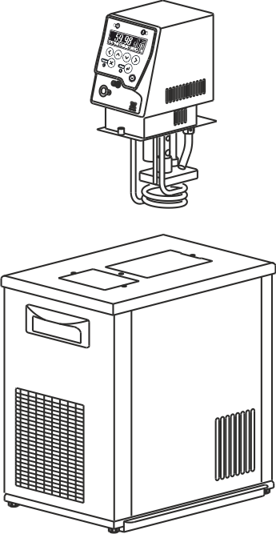
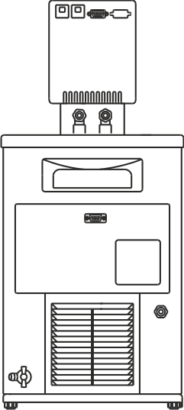
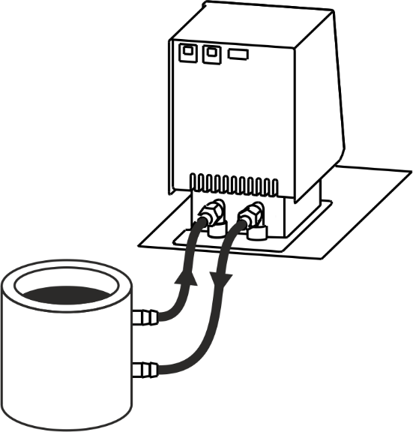
Cryogenic unit
Main view
Back view
Reactor connection
Control module
Refrigerated bath
Figure 2 – Cryogenic unit
Notes:
Cryogenic unit - the cryogenic unit shown on the slide consists of a refrigeration bath and a control unit. The coolant is poured into the refrigeration bath. The control unit is installed in the bath with the coolant that circulates through a closed system between the reactor and the bath by means of a pump. The temperature of the circulating thermal fluid is between -45 and -60 °C.

Slide 13
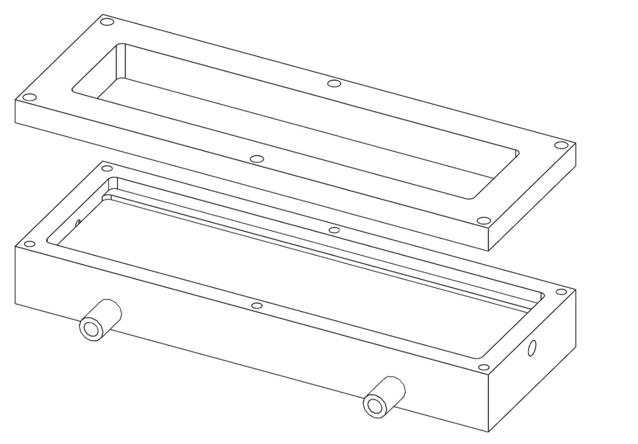
Plasma-chemical reactor design
Reactor cover
Top
Reactor vessel
Bottom
Cooling Tubes
Figure 3 – 3D model of plasma-chemical reactor
Notes:
Reactor - the reactor model shown on the slide has a 2-level design. The lower level is used for cooling the reactor and the upper level for initiating oxidation under the barrier discharge.

Slide 14
Cryogenic unit
Plasma-chemical reactor
Assembly of the units
Testing
Notes:
Most of the first year's work plan has already been done. A plasma chemical reactor and a cryogenic unit have been produced. The next step is to assemble a test bench and test the pilot unit under different operating conditions, and to identify the difficulties we may encountered during operation and handle them accordingly.

Slide 15
Thank you for your attention☺
Notes:
All in all the work proposed goes as planned. It’s a shame I can’t share more with you as of now, but I enjoyed talking before you and I hope I’ll have a chance to tell more in plain English in the future. Thank you for listening and if you have questions, I’d be happy to try answering them.

